Slide 1


SAP UI5 & FIORI with OData TRAINING using BAS
Anubhav Oberoy
Day – 18

Slide 2

Agenda – Day 17
Fragments
Different Ways of loading fragment
Value Help Popup
What is OData?
oData Basics.
Structure of Odata.
Client Side Query With Odata.
Get Operations.
SAP Deployment Options
TCodes and Services
Data Model for our use case
Creating OData Service.
Building Get Entity set Method
Testing the Get Entity set Method in Browser
Building Get Entity method (Single Product)
Introduction to the Postman Tool
Setting the Authorization in Postman
Testing Get Entity and Entity set using Postman
Implementing Create in OData Service
Testing POST calls in the SAP Logon
Testing POST calls using postman
How to set payload in postman to test POST call
Introduction to x-csrf-token
Implementing Update and Delete in service
Adding Supplier Entity set
Introduction to Association
Associating Supplier Set to Product Set
Introduction to Function Import
Creating a Function to get Most expensive product
Basics of Connectivity
Introduction to Cloud Connector
Steps to Setup the Cloud Connection.
Creating the destination in the BTP for BAS
Creating the destination in the Vscode

Slide 3
Fragments
Fragments are light-weight UI parts. They are used to modularize views. We can reuse a fragment multiple times in same view or other views.
Fragments are used similar as sap.ui.core.mvc.Views, but Fragments do not have their own controllers. Logic related to fragment’s UI elements is written in the host view’s controller.
Fragments are like parasite, they rely on the controllers of the host views.
There are 2 techniques to create and work with fragments
Direct embedding using fragment
Use JS class sap/ui/core/Fragment and use load function to load it
View1
Controller1
Address – street, house, city, country
fragment
B
Event for fragment button
fragment
B
View 2
Controller2
fragment
Event for fragment button
B

Slide 4


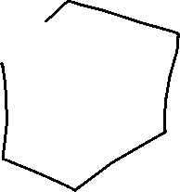



























Slide 5
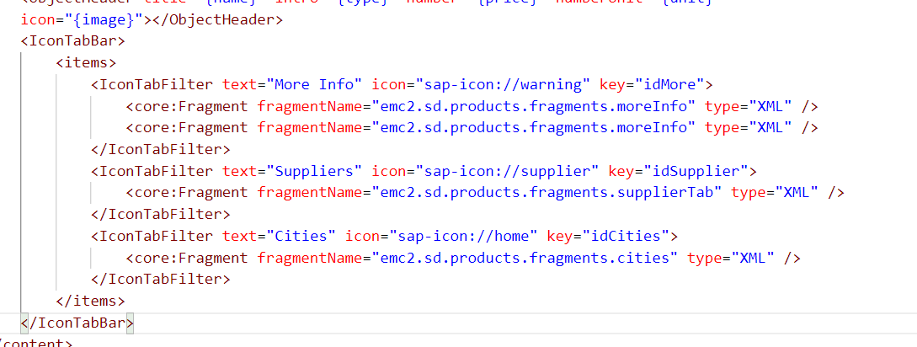
Hands – on: Embedding Fragment in View
For this hands – on we have to create a folder named fragments in the webapp folder and in that folder create fragment files with the extension .fragment.xml.
We will move the Icon Tab bar code to the fragments and will embed them in the View2 to modularize the code of View2.
Create three file in the fragments folder for more Info Section, Supplier Table section and Cities Section.
To including the fragment directly into the XML View use the sap.ui.core.Fragment class as shown below
Ex: <core:Fragment fragmentName=“namespace.fragments.fragmentName" type="XML" />
Code Links:-
View2.view.xml
moreInfo.fragment.xml
cities.fragment.xml
supplierTab.fragment.xml

Slide 6
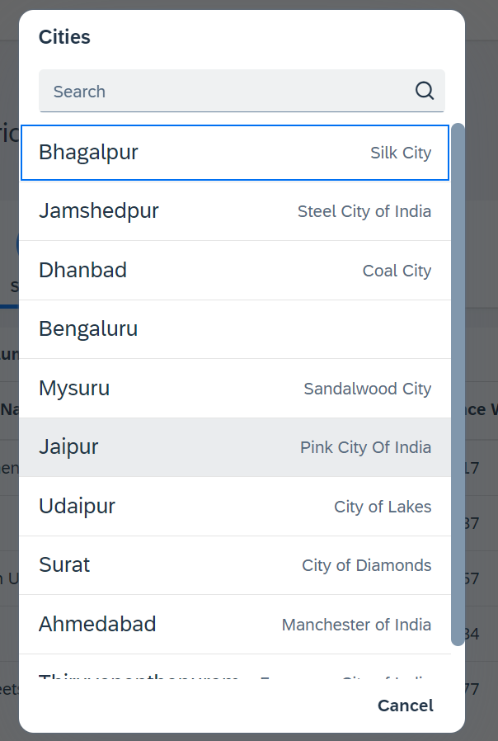
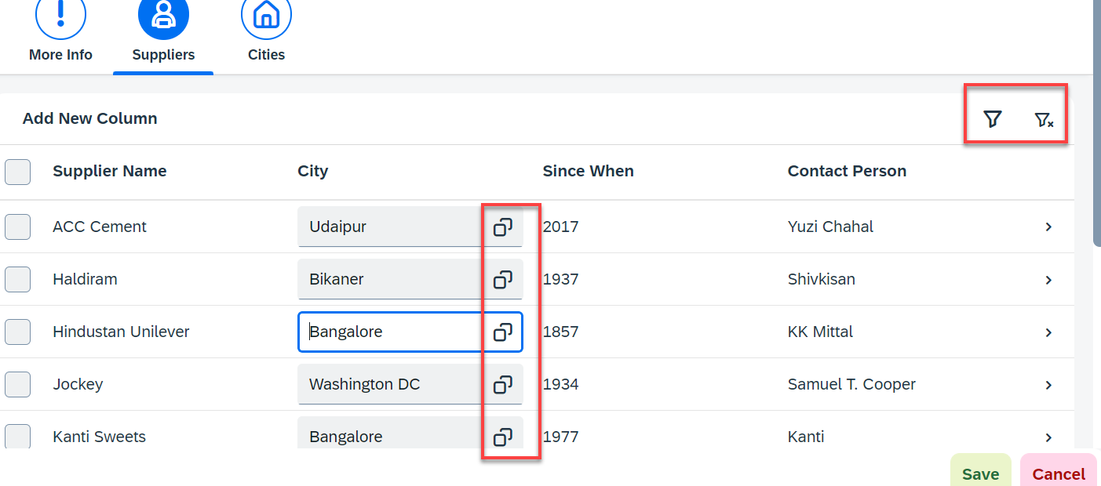
Hands – on: Fragment Use Case 2 (Using JS Code)
My manager asked me to develop following requirements
Add a filter button in the toolbar of the table, and when we click filter icon, it should load a popup with all the list of suppliers. When we select supplier inside filter it should filter data in the table.
Inside the table we have a city field. We would like to enable a value help (F4 Help), when we click on same, it should open a popup which shows all the list of cities on screen.
Part 1: Opening filter popup using the Filter Button.
popup.fragment.xml
supplierTab.fragment.xml
View2.controller.js
Part 2: Opening the Value help popup in the Supplier Table
popup.fragment.xml
supplierTab.fragment.xml
View2.controller.js

Slide 7

End of Day 18

Slide 8

Questions

Slide 9

Sakshi Gupta

Slide 10


We’re committed to empower you to be
Most Desirable Resource
through powerful training solutions.
We build the workforce of the future.
250+
Corporate Clients
30,000+
Learners Trained
25000+
Learners Placed
FREE WEBINARS
Sign up for free webinars with industry experts every fortnight!
Enroll Now!
Contact us today!
https://anubhavtrainings.com/

Slide 11
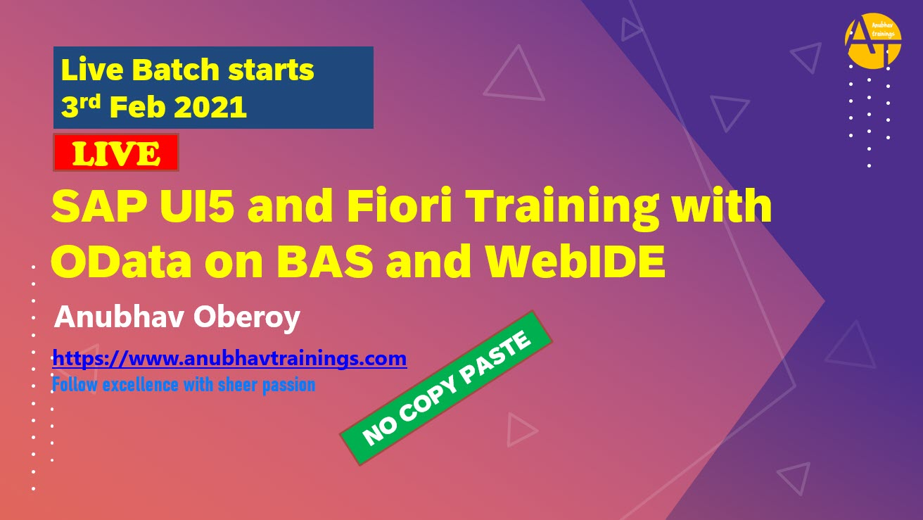


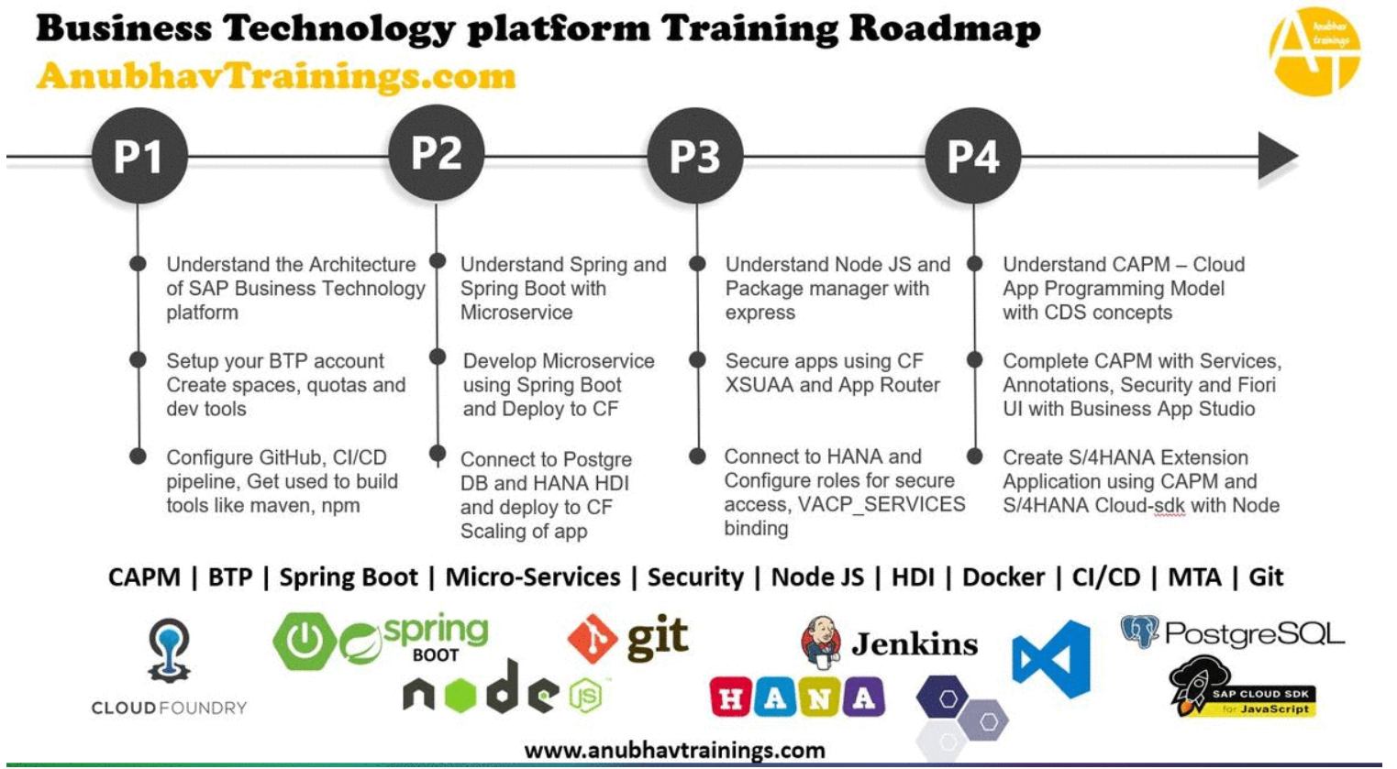
More from AnubhavTrainings.com

Slide 12
Title
Content

